Slide 1
Week 11
Recursion

Slide 2
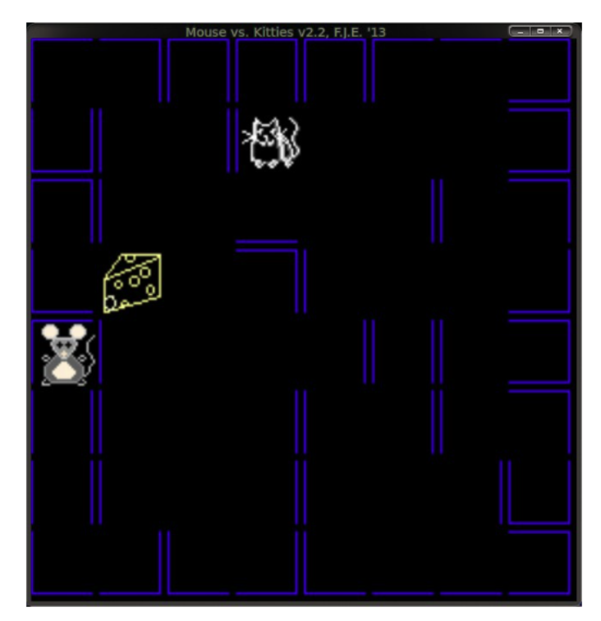
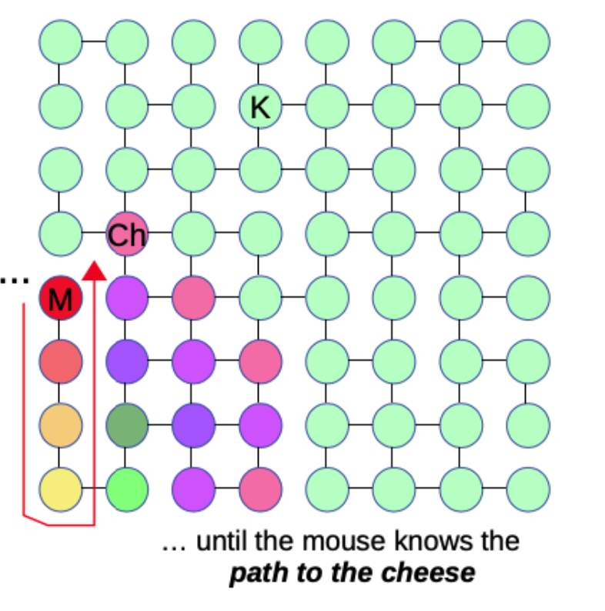
Recursive graph search
Notes:
Problem: How do we find a path from the mouse to the cheese? In terms of our graph this means finding a path from the node labeled ‘M’ to the node labeled ‘Ch’. For you, looking at the graph above, it’s very easy to see the path the mouse should take. For a computer working on a graph this is not so simple.

Slide 3
Recursive Approach
find path to cheese:
Ask my neighbours: What is the path from you to cheese
They ask their neighbours: What is the path from you to cheese
They ask their neighbours ....
... until { one of the neighbours-neighbours...neighbours is the cheese!
Now one of the cheese’s neighbour knows where to go
Then a cheese’s neighbour’s neighbour knows where to go
... until, the mouse knows where to go!

Slide 4
What is Recursion?
Function calling itself!!
int f1()
{
…
f1();
…
}
One of the common interview question:
How would you explain recursion to your 5 year old nephew?
[Source: Reddit]
Notes:
How do you explain recursion to a 4 year old? This is a pretty famous interview question, and there are loads of answers available on the web. We won’t answer this question as it is too mainstream.
If you are as clever as I am ??, you would explain recursion to someone one year younger than you. Have them explain recursion to someone one year younger than them. Continue until you have a 5 year old explaining recursion to a 4 year old. Done. [Source: reddit].

Slide 5
Why Use Recursion?
Fewer Lines of Code
  usually results in a solution with fewer lines of code than a solution that does not utilize recursion.
More Elegant Code
  Intuitively easy to understand
Increased Readability
Notes:
Fewer Lines of Code
Applying recursion usually results in a solution with fewer lines of code than a solution that does not utilize recursion.
More Elegant Code
In addition to fewer lines of code, recursive solutions are typically more pleasing to look at. In other words, recursive solutions are usually considered to be elegant.
Increased Readability
Reasons 1 and 2 typically combine to create reason 3 which is the increased readability of your code. Remember, we do not write code just for ourselves. We write code for the developers that follow us and must understand our code.
Reasons NOT to Use Recursion
Performance losses
Repeating function calls is not as efficient or performant as applying a loop. We do not want to simply choose recursion because we can.
Debugging Issues
The logic of recursion is not always easy to follow. Utilizing recursion may make your code more difficult to debug.
Is the Readability Improved?
Increased readability is not guaranteed through the use of recursion. In fact, this may by opinionated and/or situational. You should evaluate the readability, and if it's not improved recursion may not be the best answer.

Slide 6
When to use recursion?
For kind of problems where
The problem is progressively broken down, made smaller, or otherwise simplified at each step.
Then information needed to form the solution is passed back one step at a time, until the solution for the original problem is obtained.

Slide 7
Divide-and-Conquer Strategy
Problem
SubProblem
SubProblem
Solve SubProblem
Solve SubProblem
Solve SubProblem
Solve SubProblem
Notes:
The divide and conquer approach as the name suggests divides the given problem in parts and then each problem is solved independently. When we keep dividing the problem into smaller parts a moment comes when the problem cannot be divided further into smaller part, then those smaller parts are solved and the solution of all those smaller parts or sub-parts is finally merged to obtain the solution of the original problem.
Divide-and-conquer methods are behind some of the most powerful tools we can find in computer science – including binary search, quicksort, the Fast Fourier Transform (used extensively in signal processing and signal analysis), mergesort (a sorting algorithm with a guaranteed worst-case- com- plexity of O(NLog(N)), and the binary space-partitioning trees for determining object visibility in computer graphics.
They are naturally recursive in that by definition they work by splitting a problem into smaller and smaller instances, applying to each of these the same algorithm, until the problem is easily solvable; then combining solutions for smaller instances of the problem to build the solution to larger and larger instances all the way back to the original one.

Slide 8
Merge Sort - Array Merging
8
1
3
2
2
3
7
4
9
5
1
7
4
8
5
9
2
3
7
8
1
4
5
9
Complexity of array merging for n elements?
O(1)
O(log n)
O(n)
O(n²)
Notes:
SUppose the cost is copying array elements. How many elements are copied?
Suppose the cost is comparing elements
How many comparisons???

Slide 9
Merge Sort - Splitting
8
3
2
7
9
1
4
5
8
3
2
7
9
1
4
5
8
3
2
7
9
1
4
5
8
3
2
7
9
1
4
5

Slide 10
Merge Sort - Merging
1
2
3
4
5
7
8
9
2
3
7
8
1
4
5
9
3
8
2
7
1
9
4
5
8
3
2
7
9
1
4
5

Slide 11
Merge Sort : Order of Growth
N
N/2
N/2
N/4
N/4
N/4
N/4
N/8
N/8
…..
Notes:
There are some caveats: what happens when the array size is cannot be cut in half??
Actual explanation in the textbook CLRS is tedious.
But for now we can consider simple case and go with this example.

Slide 12
General Principle of Recursion
int f1()
{
f1();
…
}
//Base case:
//terminating condition
//Recursive case:
Notes:
The problem itself is complex.
• But it can be broken down into smaller, or simpler versions of itself.
• The same process applies to the original problem, and to the progressively smaller/simpler
instances of it.
• At some point, the solution to one of the small problems becomes easy to compute, we can stop breaking down into smaller problems and simply return the solution.
• The process now goes back building a solution for larger and more complicated subproblems until the original problem is solved.

Slide 13
Structure of Recursive Solution
Base Case:
  simplest form of the problem where recursion is not required (terminating condition)
    Strings: empty string
    Numeric arrays: array with 1 entry
    Graphs: single node
    Search problems: empty node/subtree/ or node with item
Recursive Case:
  Make the problem smaller, closer to the base case
  This includes split, simplify, recursively calling with smaller subproblems
  Merging/re-constructing solution to original problem
    Strings: breaking string into chunks
    Numeric arrays: splitting arrays into sub-arrays
    Graphs: processing on subsets of the graph
    Trees: splitting into subsets of tree
    Search: searching on subsets of data structure
Notes:
By now you should have an intuitive understanding of the following general principles that are part of every recursive problem, and will therefore form the basis of coming up with a recursive solution to any of these problems:
Because of the properties noted above, we can say that every recursive solution to a problem will have the following components:
1. A Base Case: This represents the simplest (trivial) form of the problem being solve, for which the answer can be computed and returned without additional recursion.
Examples:
• For strings, the base case often is an empty string, or a string with one char
• For numeric arrays, the base case often is an array with 1 entry, or an empty array
• For graph problems, the base case often involves a graph with a single node, or a graph where the node being processed has a specific property (e.g. for mapping applications, it could be that the node being processed represents the location we’re looking for)
• For search (on lists, trees, or other data structures) the base case is often having reached an empty sub-list, or sub-tree, or having found the item we’re searching for.
Note: As you can see there can be several different base cases for a given problem. You have to think about all that apply to your problem – we say ‘often’ in the examples above because depending on the problem the base case may be something different. Once again you have to figure out what is appropriate given your problem. What is critical is to ensure there is a base case, otherwise your recursion will not end!
2. The Recursive Case: This is the general case, where we split, simplify, or otherwise make the problem smaller and closer to the base case. It
involves thinking about how to break down a given problem, and involves recursively calling the function with the smaller sub- problem(s). The recursive case implementation is also responsible for re-constructing the solution for the original problem from solutions for the smaller, simpler sub-problems.

Slide 14
Designing Recursive solution
Base case:
  Think of the smallest version of the problem and write down the solution
  Think of the case when the solution to the problem is not found
Recursive case:
  Split the problem into subproblems that will get you closer to the base case
  Many possible ways to do this
  Choose the splitting solution that will make the recursive case simpler(fewer steps)
Combine base case and recursive case
Things to keep in mind:
  Cover all the instances for all input sizes
  Base case should not make recursive calls
  Recursive calls should call a smaller instance of original input
  Take that “Recursive leap of faith”
Notes:
Wh
at should the the base case for this problem? How many different base cases are there?
Have you found all of them?

Slide 15
Sorting an array
7
9
4
8
3
5
Base Case:
Empty array
Array with 1 value
Recursive Case:
Split the problem
How?
Notes:
This is a very short array, but you know that you should have in the back of your mind the consideration of the complexity of your solution for very large arrays.
What is the base case?
The base case for sorting arrays is either an empty array, or an array with one value. Both of these cases are already in sorted order. You can easily come up with examples that show that a 2-entry array is not in sorted order.
How about the recursive case?
As noted above, there are many ways in which we could split our problem into sub-problems that are closer to the base case. We also said that depending on the choice we will end up with simpler/more intuitive solutions, or with more complex solutions. And that the different possibilities may result in algorithms that are less or more efficient.
Let’s have a look at three different ways we could split the problem of sorting an array, each of which leads to a different sorting method. We will spend a moment thinking about the complexity of our sorting process for each of the proposed recursive cases, and this will help you understand and remember that you have to think very carefully about what’s the appropriate way to split the problem you need to solve.

Slide 16
Insertion Sort
7
9
4
8
3
5
Recursive Case:
Split the array such that first entry into first subarray
Remaining into second subarray
Recursively sort each subarray
Merge sorted subarrays to build larger subarrays
Instructors: E. Estrada, M. Ponce, P. Gawde
Notes:
Solution Idea
This is also an in-place comparison-based sorting algorithm. During the insertion sort algorithm, the array or list is divided into two parts: the sorted part at the left end and the unsorted part at the right end.
At each step of the iteration, we are adding one value from the unsorted part to the sorted part. or we can say that our size of the sorted part is growing by 1 after each step of iteration. Here we pick the first element of the unsorted part and find its correct place to insert in the partially sorted array.
This is an incremental design approach to solve the problem in algorithms where the partial solution is growing after each step of the iteration.

Slide 17
Insertion Sort
Instructors: E. Estrada, M. Ponce, P. Gawde
Notes:
This is also an in-place comparison-based sorting algorithm. During the insertion sort algorithm, the array or list is divided into two parts: the sorted part at the left end and the unsorted part at the right end.
At each step of the iteration, we are adding one value from the unsorted part to the sorted part. or we can say that our size of the sorted part is growing by 1 after each step of iteration. Here we pick the first element of the unsorted part and find its correct place to insert in the partially sorted array.
This is an incremental design approach to solve the problem in algorithms where the partial solution is growing after each step of the iteration.

Slide 18
Insertion Sort
7
9
4
8
3
5
7
9
4
8
3
5
Recursive Case:
Split the array such that
  first entry into first subarray
  Remaining into second subarray
Recursively sort each subarray
Merge sorted subarrays to build larger subarrays
7
9
4
8
3
5
7
9
4
8
3
5
7
9
4
8
3
5
7
9
4
8
3
5
Instructors: E. Estrada, M. Ponce, P. Gawde

Slide 19
Insertion Sort
3
4
5
7
8
9
7
3
4
5
8
9
Recursive Case:
Split the array such that
  first entry into first subarray
  Remaining into second subarray
Recursively sort each subarray
Merge sorted subarrays to build larger subarrays
7
9
3
4
5
8
7
9
4
3
5
8
7
9
4
8
3
5
7
9
4
8
3
5
Instructors: E. Estrada, M. Ponce, P. Gawde

Slide 20
Complexity of Insertion Sort
3
4
5
7
8
9
7
3
4
5
8
9
7
9
3
4
5
8
7
9
4
3
5
8
7
9
4
8
3
5
7
9
4
8
3
5
Instructors: E. Estrada, M. Ponce, P. Gawde

Slide 21
Insertion sort intuitive idea
Sorting set of cards in our hand
7 ❤
9 ♣
4 ♠
8 ♦
3 ❤
5 ♣
3 ❤
5 ♣
8 ♦
4 ♠
7 ❤
9 ♣
Instructors: E. Estrada, M. Ponce, P. Gawde

Slide 22
Insertion Sort
3
4
5
7
8
9
3
4
5
7
9
8
3
4
7
9
5
8
4
7
9
3
5
8
7
9
4
8
3
5
7
9
4
8
3
5
Instructors: E. Estrada, M. Ponce, P. Gawde

Slide 23
Insertion Sort Pseudocode
InsertionSort(int arr [], int n)
{
// Base case
if (n <= 1)
return
// Sort first n-1 elements
InsertionSort( arr, n-1 )
int key = arr[n-1]
int pos = n-2
while (pos >= 0 && arr[pos] > key)
{
arr[pos+1] = arr[pos]
pos = pos - 1
}
arr[pos+1] = key
}
Solution Steps
Base Case:
  If array size is 1 or smaller, return.
Recursive case:
  Recursively sort first n-1 elements.
  Insert the last element at its correct position in the sorted array.
Instructors: E. Estrada, M. Ponce, P. Gawde
Notes:
Solution
The problem expects us to sort an array using Insertion sort and we have to do it recursively. You can read about insertion sort here.
Now, we know that Recursion is made for solving problems that can be broken down into smaller, repetitive problems. In this case, we can define our smaller problems in this way “we have a sorted array and now we have to insert a number in that sorted array”.
Now, every recursive function requires a base case for its termination. In this case, we can say that if the array is of size 1, then the array is already sorted and we can simply return from there.
Now, the problem is to find a way to insert a value in a sorted array and that can be done as shown in the above visualization. We will simply shift the array elements to find the right position for the new element. As soon as we place the new element in its correct position, our sorted array size will increase by one.

Slide 24
Example - splitting the array
InsertionSort(int arr [], int n)
{
// Base case
if (n <= 1)
return
// Sort first n-1 elements
InsertionSort( arr, n-1 )
int key = arr[n-1]
int pos = n-2
while (pos >= 0 && arr[pos] > key)
{
arr[pos+1] = arr[pos]
pos = pos - 1
}
arr[pos+1] = key
}
main()
{
InsertionSort(arr = [ 7, 9, 4, 8, 3, 5 ], 6)
}
arr = [ 7, 9, 4, 8, 3, 5 ], size = 6
insertion-sort(arr, 6)
insertion-sort(arr, 5)
insertion-sort(arr, 4)
insertion-sort(arr, 3)
insertion-sort(arr, 2)
insertion-sort(arr, 1)
Instructors: E. Estrada, M. Ponce, P. Gawde

Slide 25
Example:
InsertionSort(int arr [], int n)
{
// Base case
if (n <= 1)
return
// Sort first n-1 elements
InsertionSort( arr, n-1 )
int key = arr[n-1]
int pos = n-2
while (pos >= 0 && arr[pos] > key)
{
arr[pos+1] = arr[pos]
pos = pos - 1
}
arr[pos+1] = key
}
main()
{
InsertionSort(arr = [ 7, 9, 4, 8, 3, 5 ], 6)
}
arr = [ 7, 9, 4, 8, 3, 5 ], size = 6
insertion-sort(arr, 1)
insert 9
return arr = [7, 9]
insertion-sort(arr, 2)
insert 4
return arr = [4, 7, 9]
insertion-sort(arr, 3)
insert 8
return arr = [4, 7, 8, 9]
insertion-sort(arr, 4)
insert 3
return arr = [3, 4, 7, 8, 9]
insertion-sort(arr, 5)
insert 5
return arr = [3, 4, 5, 7, 8, 9]
insertion-sort(arr, 6)
Instructors: E. Estrada, M. Ponce, P. Gawde

Slide 26
Insertion sort
insertion-sort(arr, 6)
insertion-sort(arr, 5)
insertion-sort(arr, 4)
insertion-sort(arr, 3)
insertion-sort(arr, 2)
insertion-sort(arr, 1)
arr = [ 7, 9, 4, 8, 3, 5 ], size = 6
insertion-sort(arr, 1)
key = arr[1] = 9
pos = 0
while (0 >= 0 && arr[0] > 9)
{
}
arr[0+1] = 9
arr = [7, 9]
insertion-sort(arr, 2)
key = arr[2] = 4
pos = 1
while (pos >= 0 && arr[pos] > 4)
{
arr[pos+1] = arr[pos]
pos = pos - 1
}
arr[-1+1] = 4
arr = [4, 7, 9]
InsertionSort(int arr [], int n)
{
// Base case
if (n <= 1)
return
// Sort first n-1 elements
InsertionSort( arr, n-1 )
int key = arr[n-1]
int pos = n-2
while (pos >= 0 && arr[pos] > key)
{
arr[pos+1] = arr[pos]
pos = pos - 1
}
arr[pos+1] = key
}
main()
{
InsertionSort(arr = [ 7, 9, 4, 8, 3, 5 ], 6)
}
Instructors: E. Estrada, M. Ponce, P. Gawde

Slide 27
Quick Sort
Instructors: E. Estrada, M. Ponce, P. Gawde
Notes:
This is also an in-place comparison-based sorting algorithm. During the insertion sort algorithm, the array or list is divided into two parts: the sorted part at the left end and the unsorted part at the right end.
At each step of the iteration, we are adding one value from the unsorted part to the sorted part. or we can say that our size of the sorted part is growing by 1 after each step of iteration. Here we pick the first element of the unsorted part and find its correct place to insert in the partially sorted array.
This is an incremental design approach to solve the problem in algorithms where the partial solution is growing after each step of the iteration.

Slide 28
Quicksort
7
9
4
8
3
5
Recursive Case:
Pivot is chosen at random
Two subarrays are created:
  One subarray with all entries ≤ Pivot
  Another subarray with entries > Pivot
Recursively sort each subarray until the base case is reached
Merge sorted subarrays to build larger subarrays
Instructors: E. Estrada, M. Ponce, P. Gawde

Slide 29
Quicksort
Idea of Quicksort
  Partition array A into A[1..q − 1], A[q], and A[q + 1..n] such that
    Each element in A[1..q − 1] is ≤ A[q].
    Each element in A[q + 1..n] is > A[q].
  The element A[q] is called pivot.
  Recursively sort (in place) each subarray.
Average complexity:
  O(n log n)
Worst case complexity:
  O(n²)
Instructors: E. Estrada, M. Ponce, P. Gawde

Slide 30
Quicksort Example
Pivot: 4
2
1
4
3
7
5
6
quickSort(arr[], start, end)
{
if (start < end)
{
/* pIndex partitioning index, arr[pIndex] is now at right place */
pIndex = partition(arr, start, end);
quickSort(arr, start, pIndex - 1); // Before pIndex
quickSort(arr, pIndex + 1, end); // After pIndex
}
}
2
1
3
4
7
5
6
Pivot: 2
1
2
3
4
5
6
7
Pivot: 6
Final result:
1
2
3
4
5
6
7
Instructors: E. Estrada, M. Ponce, P. Gawde
Notes:
Some algorithms have terrible worst-case times, but:
on random input, they are fast on average
or, they contain randomizing steps, and are fast on average
We will study their “average case” times

Slide 31
Quicksort Example
quickSort(arr[], start, end)
{
if (start < end)
{
/* pIndex partitioning index, arr[pIndex] is now at right place */
pIndex = partition(arr, start, end);
quickSort(arr, start, pIndex - 1); // Before pIndex
quickSort(arr, pIndex + 1, end); // After pIndex
}
}
arr
1
6
2
3
7
5
4
6
1
2
3
7
5
4
pIndex
i
6
1
2
3
7
5
4
pIndex
i
partition (arr[], start, end)
{
pivot = arr[end]
pIndex = start
for (i = start; i < end - 1; i++)
{
// If current element is smaller than the pivot
if (arr[i] < pivot)
{
swap arr[pIndex] and arr[i]
pIndex ++
}
}
swap arr[pIndex] and pivot
return pIndex
}
1
6
2
3
7
5
4
pIndex
i
1
2
6
3
7
5
4
pIndex
i
1
2
3
6
7
5
4
pIndex
i
1
2
3
6
7
5
4
pIndex
i
1
2
3
4
7
5
6
pIndex
Instructors: E. Estrada, M. Ponce, P. Gawde
Notes:
Some algorithms have terrible worst-case times, but:
on random input, they are fast on average
or, they contain randomizing steps, and are fast on average
We will study their “average case” times

Slide 32
Quicksort Example - Best Case
Instructors: E. Estrada, M. Ponce, P. Gawde
Notes:
Quicksort is an algorithm that
Some algorithms have terrible worst-case times, but:
on random input, they are fast on average
or, they contain randomizing steps, and are fast on average
We will study their “average case” times

Slide 33
Quicksort Example - Best Case
Pivot: 4
2
1
4
3
7
5
6
Pivot: 3
2
1
3
4
7
5
6
Pivot: 2
1
2
3
4
5
6
7
Pivot: 6
Final result:
1
2
3
4
5
6
7
Instructors: E. Estrada, M. Ponce, P. Gawde
Notes:
Quicksort is an algorithm that
Some algorithms have terrible worst-case times, but:
on random input, they are fast on average
or, they contain randomizing steps, and are fast on average
We will study their “average case” times

Slide 34
Quicksort Example - Worst Case
1
2
3
4
5
6
1
2
3
4
5
1
2
3
4
1
2
3
1
2
4
5
6
7
1
2
3
4
5
6
7
1
2
3
4
5
6
7
Instructors: E. Estrada, M. Ponce, P. Gawde
Notes:
Some algorithms have terrible worst-case times, but:
on random input, they are fast on average
or, they contain randomizing steps, and are fast on average
We will study their “average case” times

Slide 35
Quicksort Example - Worst Case
Pivot: 7
1
2
3
4
5
6
7
Pivot: 6
1
2
3
4
5
6
7
Pivot: 5
1
2
3
4
5
6
7
Pivot: 4
1
2
3
4
5
6
7
Pivot: 3
1
2
3
4
5
6
7
Pivot: 2
1
2
3
4
5
6
7
1
2
3
4
5
6
7
Final result:
1
2
3
4
5
6
7
Instructors: E. Estrada, M. Ponce, P. Gawde
Notes:
Some algorithms have terrible worst-case times, but:
on random input, they are fast on average
or, they contain randomizing steps, and are fast on average
We will study their “average case” times
Empirically we consider not worst, not best but average case which ends up as nlog n
Rigorous proof requires probability theory, calculus. But intuition and empirical analysis
As we discussed in the previous unit, quicksort has an average complexity of O(NLog(N)). If we’re not unlucky with our choice of pivots, each split creates sub arrays that are roughly of equal size. In that case, we can expect to need approximately Log2(N) splits for the recursion to bottom out with all sub-arrays at the base case. For each level of splitting, we have to put a total of N elements into their corresponding sub array, so the cost of the splitting step is O(NLog(N)). The merging step then has to put sorted sub arrays back together – There are on average Log(N) levels, and at each level, a total of N elements must be put into bigger sorted arrays, this takes O(N) time per level. Therefore, the complexity of the merging step is on average O(NLog(N)). And the total complexity of quicksort is O(NLog(N)) on average.
We also saw that if we’re unlucky with out choice of pivot, the splitting process puts every entry except for the pivot on one sub-array, and just the pivot in the other. If this happens at every step, the process will be identical to what we got from recursive case 1) and we’re looking at a complexity of O(N2). Insertion sort again!
So recursive case 2) is much better than recursive case 1) ON AVERAGE. But we still need to worry about the potential for slowdowns with an unlucky input array.

Slide 36
Quicksort Example - Average case
N
Complexity: O(N * H)
Height
  log _{10/9}N
Complexity on Average:
  O(N log N)
N/10
9N/10
N/100
9N/100
9N/100
81N/100
Instructors: E. Estrada, M. Ponce, P. Gawde

Slide 37
Merge Sort
Instructors: E. Estrada, M. Ponce, P. Gawde

Slide 38
Merge Sort
7
9
4
8
3
5
Recursive Case:
Split the input array such that
Each subarray has half entries of the original
Recursively sort each subarray until the base case is reached
Merge sorted subarrays to build larger subarrays
Instructors: E. Estrada, M. Ponce, P. Gawde

Slide 39
Pseudocode
8
3
2
7
9
1
4
5
void mergeSort(int arr[], int left, int right)
{
//Base case
if left > right
return
//Recursive case
mid = (left+right)/2
// Sort first and second halves
mergeSort(arr, left, mid);
mergeSort(arr, mid + 1, right);
merge(arr, left, mid, right);
}
8
3
2
7
9
1
4
5
8
3
2
7
9
1
4
5
8
3
2
7
9
1
4
5
3
8
2
7
1
9
4
5
2
3
7
8
1
4
5
9
1
2
3
4
5
7
8
9
Instructors: E. Estrada, M. Ponce, P. Gawde

Slide 40
Performance
Merge Sort:
  Best case: O(N log N)
  Worst case: O(N log N)
Quick Sort:
  Best case: O(N log N)
  Worst case: O(N²)
  Randomly chosen array size: (Average Case) O(N log N)
Which one is faster?
  Quicksort
  Requires empirical analysis.
Instructors: E. Estrada, M. Ponce, P. Gawde

Slide 41
Implementation considerations for recursive methods
Instructors: E. Estrada, M. Ponce, P. Gawde

Slide 42
Memory Model
Memory model of functions:
  Non-recursive functions: Calling a function
    Reserves space for function’s parameters, variables, and return value
    Release the space after the return value is obtained
  Recursive functions: Calling function
    Reserves space for function’s parameters, variables, and return value
    Release the space after each recursive call is completed
Instructors: E. Estrada, M. Ponce, P. Gawde
Notes:
Recursion requires that a function call itself a (possibly large) number of times. Remember from all the time we spent looking at the memory model in Unit 2, that every time we call a function, space has to be reserved for the function’s parameters, variables, and return value. In non-recursive code, we don’t usually worry about it because we know that after a function is called, its work completed, and a return value obtained, all the space reserved for the function is released.
However, with recursive code this is tricky – all the space reserved will eventually be released, but not until each recursive call is completed. What that means is space reserved for function calls early in the recursive process will hang around until it receives results from the recursive calls it launched.

Slide 43
Example
void sum(int arr[], int n)
{
if (n == 0)
return arr[0];
else
return arr[n] + sum(arr, n-1);
}
int main()
{
int arr = [3, 2, 9, 10];
printf(“%d”, sum(arr, 3));
}
sum([3, 2, 9, 10], 0) = return arr [0]
return arr[0] = 3
sum([3, 2, 9, 10], 1) = arr[1] + sum(arr, 0)
return arr[1] + 3 = 2 + 3 = 5
sum([3, 2, 9, 10], 2) = arr[2] + sum(arr, 1)
return arr[2] + 5 = 14
sum([3, 2, 9, 10], 3) = arr[3] + sum(arr, 2)
return arr[3] + 14 = 24
main()
Prints 24
Function call stack
Instructors: E. Estrada, M. Ponce, P. Gawde
Notes:
The function takes an input array, and recursively computes the sum of its elements.
The base case is an array with a single entry in which case the sum is simply the value for that element (if we’re careful, we also need to add a case where the array is empty, in which case the sum is zero).
The input parameter n is used to indicate the part of the array the function is adding – it starts at the index of the last element in the array, and with each recursively call, decreases by one. This ensures that we get closer to the base case. Once the base case is reached, the recursion rebuilds the sum from the first element back to the last.
The computer needs to keep track of both of them. This is done by using a stack. A stack is nothing more than an array that has the particular property that we fill it up from the end and work out way backwards – the end of the array is called the bottom of the stack and the beginning of the array is called the top of the stack. In our example above, somewhere in memory we will have the following information in the stack:

Slide 44
Things to consider
Recursion call stack grows upwards
Depending on the input size, call stacks with individual stack frames for each recursive call can grow large!
Code can run out of stack space
Program can terminate abruptly!
Solution:
  Tail-recursive optimization
What is tail recursion?
  A tail recursive function is a function where recursive call is the last thing executed by the function.
sum(arr, 0)
sum(arr, 1)
….
sum(arr, 59)
sum(arr, 60)
main()
Function call stack
Instructors: E. Estrada, M. Ponce, P. Gawde
Notes:
You should keep the above diagram in mind - it shows that if you’re not careful with recursion, and if you don’t write your code keeping in mind how many parameters and variables you actually need, you can quickly run into memory problems by using up all the stack space reserved for your program.
It should also make you think of the overhead caused by reserving all that memory and passing parameters and return values around during a sequence of recursive calls. Carelessly written recursive code can be quite inefficient because of all that overhead.
However, if we are smart and write our code properly, we can take advantage of a technique called tail-recursion, or tail-recursive optimization.

Slide 45
Tail Recursive Optimization
A tail recursive function is a function where recursive call is the last thing executed by the function.
void sumTR(int arr[], int n, part_sum)
{
if (n == 0)
return part_sum + arr[0];
else
return sum(arr, n-1, part_sum+arr[n]);
}
int main()
{
int arr = [3, 2, 9, 10];
printf(“%d”, sumTR(arr, 3, 0));
}
sumTR([3, 2, 9, 10], 0, 21)
part_sum = 21 + 3 = 24
sumTR([3, 2, 9, 10], 1, 19)
part_sum = 19 + 2 = 21
sumTR([3, 2, 9, 10], 2, 10)
part_sum = 10 + 9 = 19
sumTR([3, 2, 9, 10], 3, 0)
part_sum = 0 + 10 = 10
main()
Function call stack
Instructors: E. Estrada, M. Ponce, P. Gawde
return arr[3] + 14 = 24
Prints 24
Notes:
In the example above, the ‘Sum()’ function reconstructs the result we want from the partial sums returned by recursive calls – the last recursive call (the one that reaches the base case) returns a value, which then is used to compute and return the next partial sum, which then is used to compute and return the next partial sum, and so on all the way back to the first call to ‘Sum()’ which computes and returns the final sum value.
This line of pseudocode takes care of this part:
The thing to notice is that once the recursive call to ‘sum()’ returns a value, we still need to add array[n] before we can return from the current call. Because the function still has work to do after the recursive call is complete, we need to have access to the local variables and parameters for this function call (which, as we know, are stored in the stack).
However, we could achieve the same result in a slightly different way. Instead of having the sum of the array be re-constructed backward from each successive recursive call, we could pass the partial sums forward into the recursion – so that the final recursive call (the one that hits the base case) can compute the final sum value and simply return it!
Let’s have a look at how we could write the sum function in that way:
In this version, the function returns the result from the recursive call directly – it doesn’t need to do any further operation or compute any further value before it can return. Put in a different way, the recursive call is the last thing the function does before returning a result. We call this form of recursion Tail Recursion.

Slide 46
Tail Recursive Optimization
A tail recursive function is a function where recursive call is the last thing executed by the function.
void sumTR(int arr[], int n, part_sum)
{
if (n == 0)
return part_sum + arr[0];
else
return sumTR(arr, n-1, part_sum+arr[n]);
}
int main()
{
int arr = [3, 2, 9, 10];
printf(“%d”, sumTR(arr, 3, 0));
}
sumTR([3, 2, 9, 10], 3, 0)
sumTR([3, 2, 9, 10], 2, 10)
sumTR([3, 2, 9, 10], 1, 19)
sumTR([3, 2, 9, 10], 0, 21)
part_sum = 0 + 10 = 10
part_sum = 10 + 9 = 19
part_sum = 19 + 2 = 21
part_sum = 21 + 3 = 24
main()
Function call stack
Instructors: E. Estrada, M. Ponce, P. Gawde
return arr[3] + 14 = 24
Prints 24
Notes:
This call reaches the base case, and returns the final value, array[0] + part sum = 29. Notice that now we don’t have to go back up the stack re-building the solution! it’s already complete the moment we reach the base case. There never was a set of active function calls in the stack. The only active call at any time is the call currently being processed.
So, by changing the way we write out recursive function a little bit – in order to pass partial results forward rather than re-building from partial results backward we have achieved the following:
• Our recursive call no longer takes up large amounts of stack space to keep track of all the active function calls
The result is available as soon as we reach the base case
Because of these two advantages, tail recursive functions can handle inputs that are much larger and require much deeper recursion to reach the base case, and we eliminate (or at least significantly reduce) the overhead of performing the recursive calls caused by all the stack management required by non-tail-recursive calls.
Modern compilers are able to take advantage of recursive functions written in this way, and the resulting code is as efficient as an equivalent loop.

Slide 47
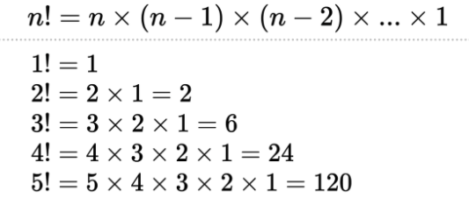
Factorial
Instructors: E. Estrada, M. Ponce, P. Gawde

Slide 48
Iteration vs Recursion vs Tail recursion
Iteration
Every recursive program can be modeled into iterative program
Recursion
Advantage:
  More elegant
  Shorter code
  Intuitive approach
Disadvantage:
  Larger problems can occupy more space
  Function call stack can grow large
Tail Recursion
Better performance since stack space is saved by the compiler
int factorial(int n)
{
int fact = 1, i;
for (i = 2; i <= n; i++)
fact *= i;
return fact;
}
int fact(int n)
{
if (n == 0)
return 1;
return n * fact(n-1);
}
int factTR(int n, int part_fact)
{
if (n == 1)
return part_fact;
return factTR(n-1, n * part_fact);
}
Instructors: E. Estrada, M. Ponce, P. Gawde
Notes:
Any problem you can solve with iterations can also be solved with recursion, and vice-versa. Both of these are general tools for problem solving. The difference will be in how natural your solution will be, and how easy to implement, maintain, and extend once written. Choosing the right tool is important

Slide 49
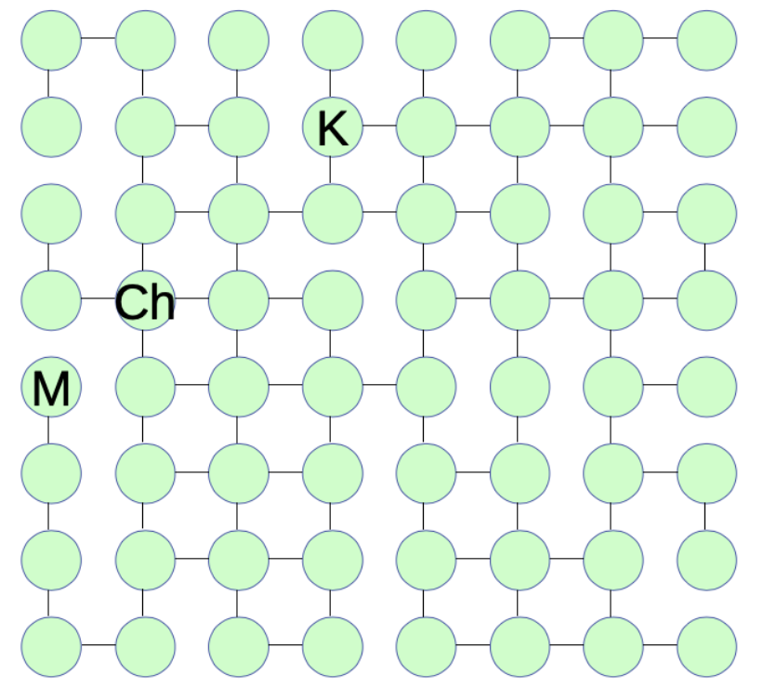
Back to Graphs
Represent with Adjacency Matrix:
  Size 64 ✕ 64
Problem: Find a path, which consists of a sequence of connected nodes, leading from the start node to the destination.
Base Case:
  Reached destination node
  No nodes left
Recursive Case:
  Finding the path from given node
  Removing current node
  Finding path from from each neighbour of the current node to the destination
  Once destination is identified, Attach current node to start of path
Instructors: E. Estrada, M. Ponce, P. Gawde
Notes:
We started this Unit by learning about graphs and the kinds of problems we can solve with them. We said that recursion is a natural tool for working with graphs since graphs are recursive in nature. Now that we have learned about recursion, let’s go back and solve the path-finding problem (from Artificial Intelligence) that we described above.

Slide 50
Graph Traversal
1
1
2
3
4
2
5
6
5
6
7
8
3
4
7
9
9
8
Instructors: E. Estrada, M. Ponce, P. Gawde
Notes:
Depth first Search or Depth first traversal is a recursive algorithm for searching all the vertices of a graph or tree data structure. Traversal means visiting all the nodes of a graph.

Slide 51
Graph Traversal
For search
Breadth First Search
v
v
2
1
2
1
3
4
5
3
4
6
v
v
7
2
1
7
2
1
8
5
3
4
8
5
3
4
6
6
Instructors: E. Estrada, M. Ponce, P. Gawde
Notes:
Depth first Search or Depth first traversal is a recursive algorithm for searching all the vertices of a graph or tree data structure. Traversal means visiting all the nodes of a graph.

Slide 52
Graph Traversal for search
Depth First Search
v
v
2
1
2
1
3
4
3
3
4
v
v
2
1
4
2
1
3
3
4
3
3
4
Instructors: E. Estrada, M. Ponce, P. Gawde
Notes:
Depth first Search or Depth first traversal is a recursive algorithm for searching all the vertices of a graph or tree data structure. Traversal means visiting all the nodes of a graph.

Slide 53
DFS - finding path
1
v
// Inputs: current node (its index in the graph)
// destination node (its index in the graph)
// Adjacency matrix (to figure out a node’s neighbours)
DFS(current, destination, A)
if current==destination
return destination // We got to base case!
else
for each neighbour of current
subpath = DFS(neighbour, destination, A)
if subpath found
// prepend current to subpath to build full path
return {current -> subpath}
return (nil) // Second base case, no subpath from current
1
2
v
1
Instructors: E. Estrada, M. Ponce, P. Gawde
Notes:
The main strategy of depth-first search is to explore deeper into the graph whenever possible. Depth-first search explores edges that come out of the most recently discovered vertex, ss. Only edges going to unexplored vertices are explored. When all of ss’s edges have been explored, the search backtracks until it reaches an unexplored neighbor. This process continues until all of the vertices that are reachable from the original source vertex are discovered. If there are any unvisited vertices, depth-ﬁrst search selects one of them as a new source and repeats the search from that vertex. The algorithm repeats this entire process until it has discovered every vertex. This algorithm is careful not to repeat vertices, so each vertex is explored once. DFS uses a stack data structure to keep track of vertices

Slide 54
DFS - finding path
// Inputs: current node (its index in the graph)
// destination node (its index in the graph)
// Adjacency matrix (to figure out a node’s neighbours)
DFS(current, destination, A)
if current==destination
return destination // We got to base case!
else
for each neighbour of current
subpath = DFS(neighbour, destination, A)
if subpath found
// prepend current to subpath to build full path
return {current -> subpath}
return (nil) // Second base case, no subpath from current
3
v
1
Instructors: E. Estrada, M. Ponce, P. Gawde
Notes:
The main strategy of depth-first search is to explore deeper into the graph whenever possible. Depth-first search explores edges that come out of the most recently discovered vertex, ss. Only edges going to unexplored vertices are explored. When all of ss’s edges have been explored, the search backtracks until it reaches an unexplored neighbor. This process continues until all of the vertices that are reachable from the original source vertex are discovered. If there are any unvisited vertices, depth-ﬁrst search selects one of them as a new source and repeats the search from that vertex. The algorithm repeats this entire process until it has discovered every vertex. This algorithm is careful not to repeat vertices, so each vertex is explored once. DFS uses a stack data structure to keep track of vertices

Slide 55
Tracing recursive calls
Which recursive call is not doing the right thing?
Add another variable (depth or level) for tracing the recursive calls at each level
Function definition:
  DFS(current, destination, Adj, depth)
The first call to DFS will look like this:
  DFS(15, 1, Adj, 0);
  (Find a path from node 15 to node 1, with adjacency matrix Adj, initial recursion depth is 0).
Within the DFS code, the recursive calls will look like this:
  subpath=DFS(neighbour, destination, Adj, depth+1);
Use either gdb or printf() to trace which recursion level these variables belong to
Instructors: E. Estrada, M. Ponce, P. Gawde
Instructors: E. Estrada, M. Ponce, P. Gawde
Notes:
Testing and debugging recursive code can be tricky. But with a bit of practice, and if you think carefully about what your recursion is supposed to be doing, you’ll be able to handle any recursive function.
What you need to understand before you start debugging
• Your base case (review that you have every base case covered, and that they are implemented) • Your recursive case (review that the splitting is reasonable, and implemented properly)
Understand how the recursive process is supposed to work, so you can determine if it is doing the right thing once you start tracing.
Tracing your recursive code
• The tricky part here is that the same function gets called over-and-over-and-over. So you need additional information in order to figure out which of the many recursive calls is not doing the right thing, and at what point things go wrong.

Slide 56
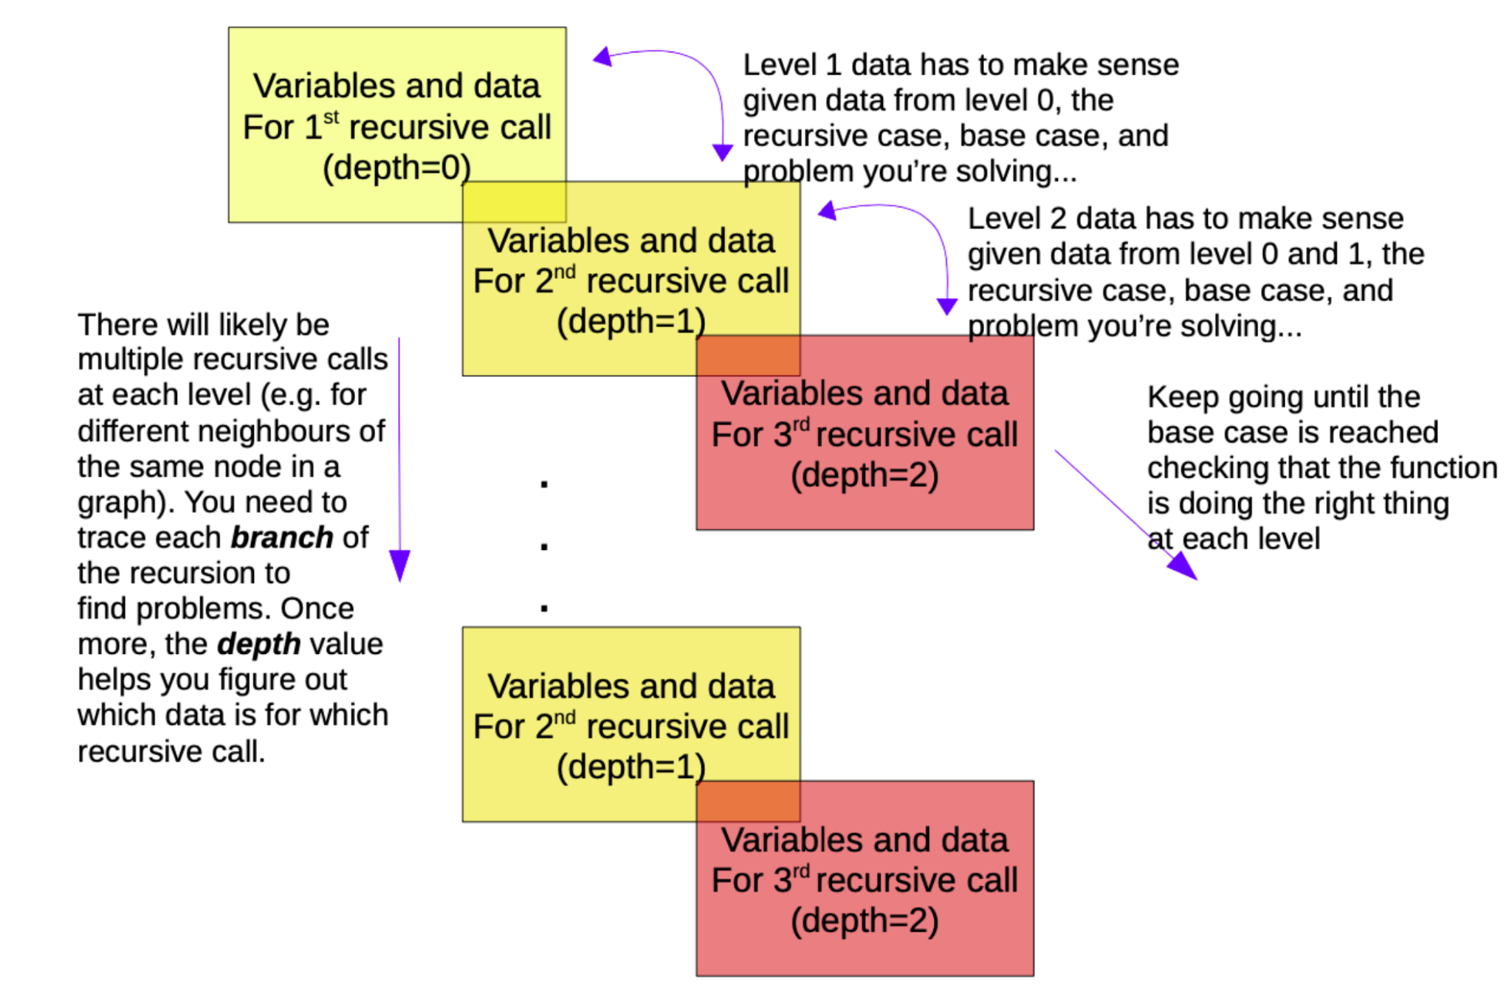
How does this help?
Image taken from Unit 5 notes
© F.Estrada, M.Ahmadzadeh, B.Harrington 2020
Instructors: E. Estrada, M. Ponce, P. Gawde
Notes:
Recursion creates a stack of function calls, so you need to print variables and parameters for each of them, and make sure that the data in each level makes sense and is correct given the level before. This is the part where you have to use your understanding of the recursive process, the base case, the recursive case, and the problem itself to figure out which part is broken, and how.
But you have all the information you need to do this! If this looks challenging at first, remember: like everything else we’ve been doing in this course, it’s just a skill you can and will master with practice. So, practice!

Slide 57
Recursion Practice Problem
Consider following recursive function:
void recur(int n)
{
if(n<1)
return;
recur(n-1);
recur(n-3);
}
If recur(6) is called from main() function, how many calls to recur() function will be invoked before returning to main()?
Instructors: E. Estrada, M. Ponce, P. Gawde

Slide 58
Recursion Practice Problem
Consider following recursive function:
void recur(int n)
{
int i = 0;
if(n>1)
recur(n-1);
for(i=0; i<n; i++)
printf(“*”);
}
How many times * is printed for recur(n)?
Instructors: E. Estrada, M. Ponce, P. Gawde

Slide 59
Take Away from Unit 5
Recursion is an intuitive approach
  Utilize when problem can be broken down in self similar manner
  Optimize stack space using tail recursion
Common recursion errors
  Never reaches base case
  Runs out of stack space
  Doesn’t return the correct solution
  Avoid such errors with the help of auxiliary variables
Recursion might look challenging, but more examples you practice, more comfortable you will get with the idea!
Instructors: E. Estrada, M. Ponce, P. Gawde

